Slide 1
Text Mining for Biomedical Data
Arzucan Özgür
Bilgisayar Mühendisliği Bölümü
Boğaziçi Üniversitesi
arzucan.ozgur@boun.edu.tr
Karmaşık Sistemler ve Veri Bilimi Çalıştayı
04.05.2019

Slide 2
General Research Areas
Natural Language Processing
Text Mining
Bioinformatics

Slide 3
Biomedical Text Mining

Slide 4
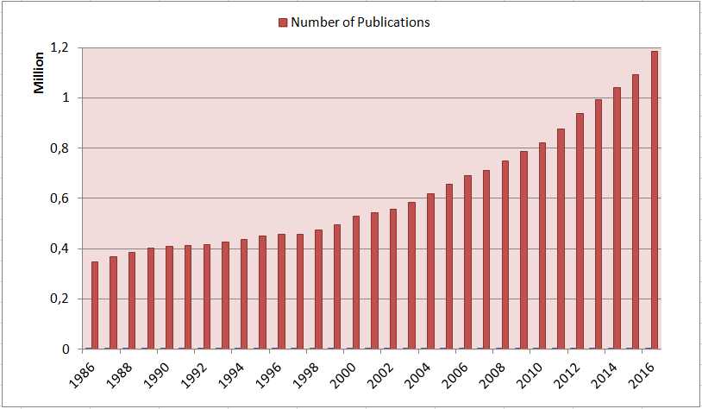
New Challenge in Bioscience: Information overload
~29M

Slide 5
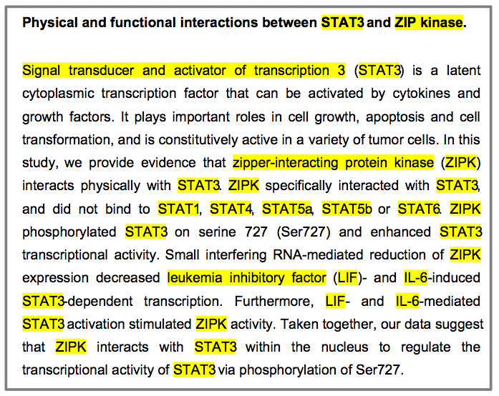
What can be extracted
Relationships (interactions)
Negation
Site
Type
Complex events
Directionality (Causality)
Speculation
cellular location

Slide 6
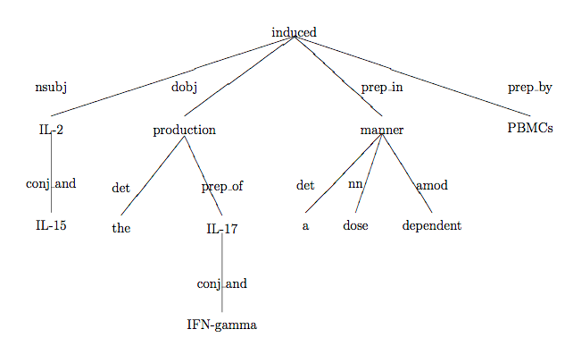
Interaction Extraction
IL-2 and IL-15 induced the production of IL-17 and IFN-gamma in a dose dependent manner by PBMCs.
(Genia Tagger: 71% F-measure)
Path between proteins: good description of semantic relation between them.
No interaction.
interaction
No interaction.
Stanford Parser is used to generate the dependency parse trees (de Marneffe et al., 2006).

Slide 7
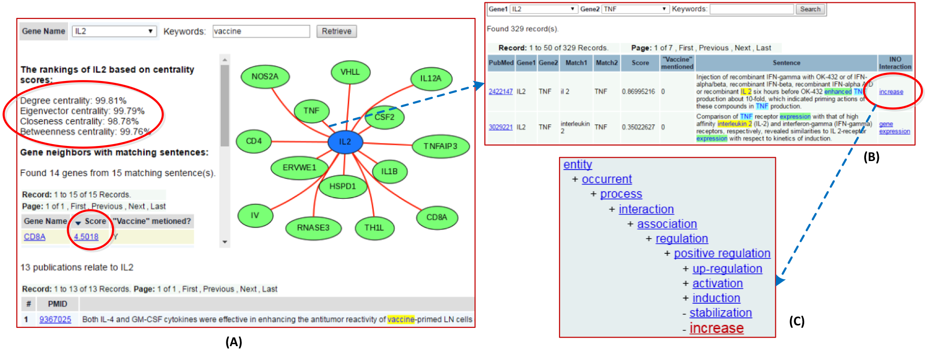
IGNET: Integrated Gene Network
Arzucan Özgür, Junguk Hur, Zuoshuang Xiang, Edison Ong, Dragomir R. Radev, Yongqun He: Ignet: A Centrality and INO-based Web System for Analyzing and Visualizing Literature-mined Networks. ICBO/BioCreative 2016
Notes:
Literatürdeki gen-gen etkileşimleri, ilgili cümleler ve etkileşim türleri otomatik olarak çıkarılmakta. Genlerin oluşturulan ağdaki önemi merkezilik ölçütleri ile belirlenmektedir
(ör: derece, eigenvektör, vb. )

Slide 8
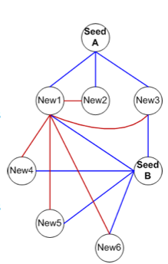
Text and Network Mining
Publications
- Concept (e.g. a disease)
- Set of genes related to the concept (seed genes)
Literature mined
concept-specific network
Degree
Eigenvector
Betweenness
Closeness
Centrality-based
network analysis
Hypothesis:
Genes central in the concept-specific gene interaction network are likely to be related to the concept.
New
concept-related genes
Used to predict genes relevant to prostate cancer, immunity, and fever

Slide 9
Predicting Prostate Cancer Genes
15 prostate cancer genes from OMIM Morbid Map used as Seed Genes
A. Ozgur, T. Vu, G. Erkan, and D. R. Radev. Identifying gene-disease associations using centrality on a literature mined gene interaction network. Bioinformatics, Volume 24, Number 13, pp. i277-i285, 2008.
Notes:
9

Slide 10
Constructing the Interaction Network
Sample extracted interaction sentences:
PTEN is transcriptionally regulated by transcription factors such as p53 and Egr-1.
In response to DNA damage, the cell-cycle checkpoint kinase CHEK2 can be activated by ATM kinase to phosphorylate p53 and BRCA1, which are involved in cell-cycle control and apoptosis.
The interactions of RAD51 with TP53, RPA and the BRC repeats of BRCA2 are relatively well understood (see Discussion).
The interaction of BRCA2 with HsRad51 is significantly more different to both RadA and RecA (Figure 2c).
The constructed graph:

Slide 11
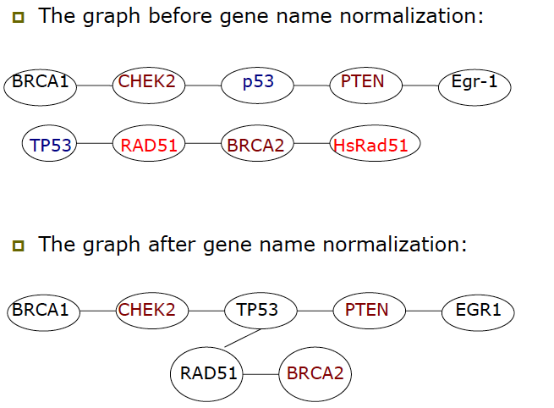
Constructing the Interaction Network

Slide 12
Ranking Genes with Graph Centrality Measures
Publications
- Concept (e.g. a disease)
- Set of genes related to the concept (seed genes)
Literature mined
concept-specific network
Degree
Eigenvector
Betweenness
Closeness
Centrality-based
network analysis
New
concept-related genes
Importance of a node in the graph

Slide 13
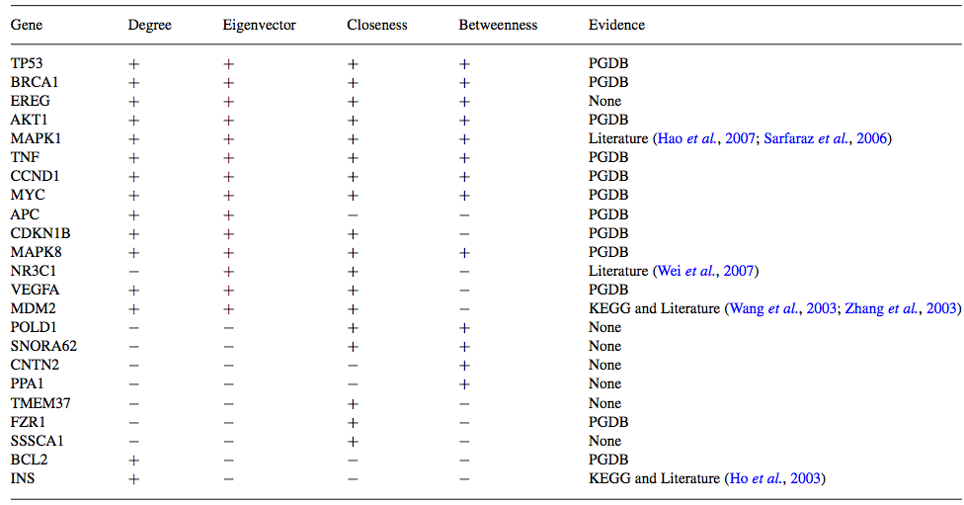
Top Ranked 20 Genes
12 genes: Prostate Gene DataBase (PGDB)
2 genes: KEGG pathway for prostate cancer and literature (MDM2 and INS)
2 genes: literature (NR3C1 and MAPK1)
7 genes: No positive or negative evidence

Slide 14
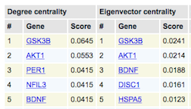
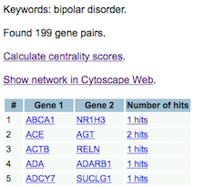
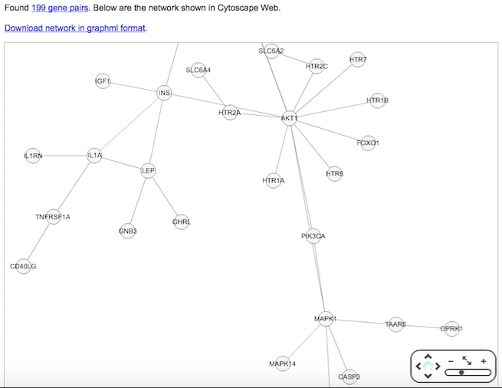
Notes:
Aranan anahtar kelime ile ilgili yayınlar otomatik olarak analiz edilmekte ve gen-gen ağı oluşturulmaktadır. Anahtar kelime ile ilgili genler sıralanmaktadır.

Slide 15
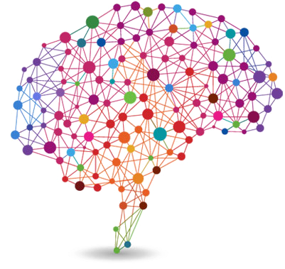
Text Mining in Neuroscince Domain: Natural Language Processing for Mining Neuroanatomical Relations Among Brain Regions
with Erinç Gökdeniz and Reşit Canbeyli
E. Gokdeniz, A. Ozgur, R. Canbeyli. Automated Neuroanatomical Relation Extraction: A Linguistically Motivated Approach with a PVT Connectivity Graph Case Study. Frontiers in Neuroinformatics, 10:39, 2016.

Slide 16
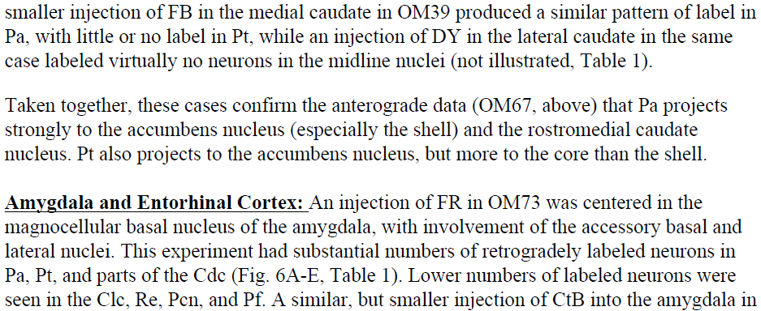
Problem Statement

Slide 17
Connectivity Graph

Slide 18
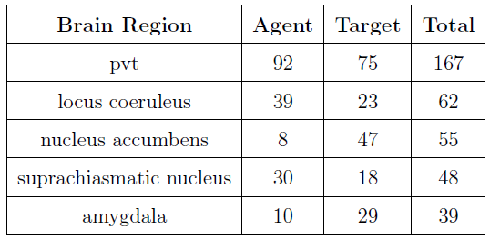
Top 5 Brain Regions with most connections

Slide 19
How is PVT case study helpful?
PVT has strong connections with
SCN, nucleus accumbens, amygdaloid complex
extended amygdala incl.
bed nucleus of the stria terminalis
ventromedial prefrontal cortex
These structures involved in mood and depression
PVT involvement in depression is not directly addressed
Only, Zhu et al. (2011) suggests that PVT neurons might be engaged in acute depressive events
Notes:
Zhu et aldan bahset

Slide 20
A chemical language based approach for drug-target interaction prediction
with Hakime Öztürk and Elif Özkırımlı

Slide 21
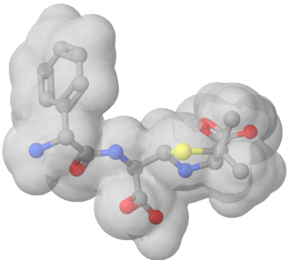
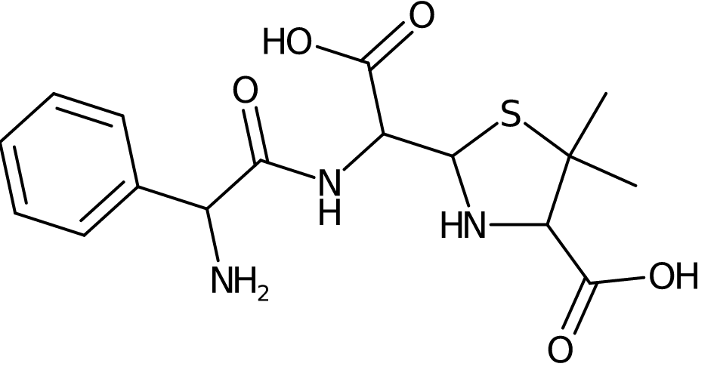
Textual Representation of Ligands and Proteins
CC1(C(NC(S1)C(C(=O)O)NC(=O)C(C2=CC=CC=C2)N)C(=O)O)C

Slide 22
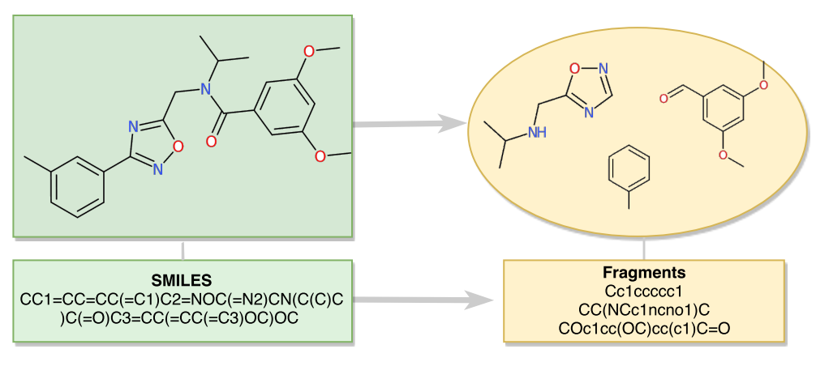
Define similarity measures based on SMILES strings. Use with machine learning algorithms.
Hakime Ozturk, Elif Ozkirimli, Arzucan Ozgur. A comparative study of SMILES-based compound similarity functions for drug-target interaction prediction. BMC Bioinformatics, 17:128, 2016.

Slide 23
SMILES is text based
Text similarity methods can be applied.
We used two approches to represent proteins using their SMILES
TF-IDF based ligand representation
Distributed ligand representation

Slide 24
Term Frequency- Inverse Document Frequency (TF-IDF)
https://www.youtube.com/watch?v=zvFGNpbAfEI

Slide 25
If we think of SMILES as a document?
SMILES: CN=C=O
Chemical words: ???

Slide 26
Chemical Words
SMILES: CN=C=O
Chemical words: CN=C

Slide 27
Chemical Words
SMILES: CN=C=O
Chemical words: CN=C, N=C=

Slide 28
Chemical Words
SMILES: CN=C=O
Chemical words: CN=C, N=C=, =C=O

Slide 29
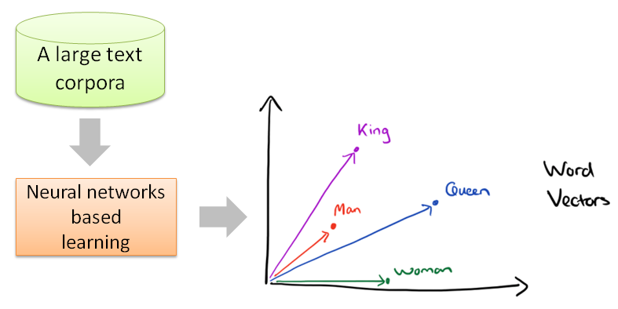
Distributed Word Representation
https://blog.acolyer.org/2016/04/21/the-amazing-power-of-word-vectors/
Mikolov, Tomas, et al. "Distributed representations of words and phrases and their compositionality." Advances in neural information processing systems. 2013.

Slide 30
Distributed Ligand Representation (SMILESVec)

Slide 31
Distributed Ligand Representation (SMILESVec)

Slide 32
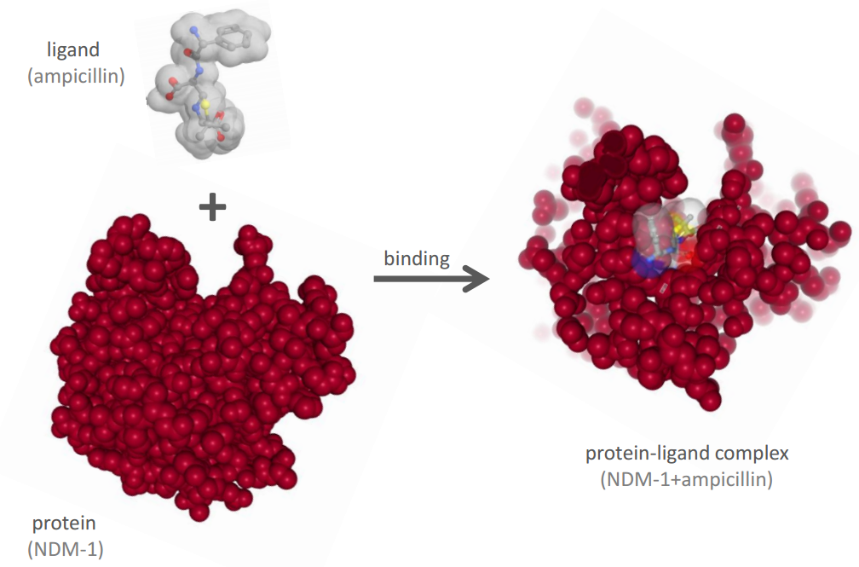
How about protein representation?
MELPNIMHPV AKLSTALAAA LMLSGCMPGE IRPTIGQQME TGDQRFGDLV FRQLAPNVWQ…..

Slide 33
Ligand based protein representation
CN=C=O
protein
Cc1ccc(O)c(OC)c1

Slide 34
SMILESVec-based Protein Representation

Slide 35
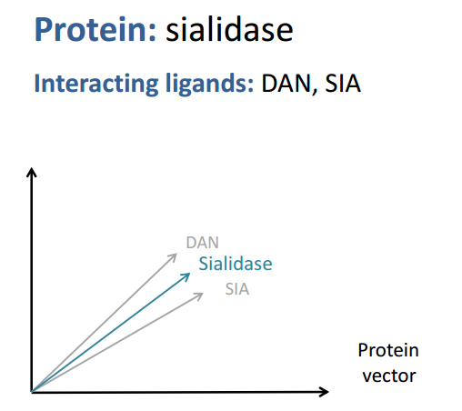
SMILESVec-based Protein Representation
Similar performance in protein clustering achieved compared to protein sequence information.
H. Ozturk, E. Ozkirimli, and A. Ozgur. A novel methodology on distributed representations of proteins
using their interacting ligands. Bioinformatics, Volume 34, Issue 13, Pages i295-i303, 2018.

Slide 36
Thank you!

